Slide 1
Uncertainty Quantification of Agent-based Models with Application to Malaria Intervention Modeling
PhD Update
April 2025

Slide 2
Aim
To quantify and propagate the uncertainty from various parameters in the OpenMalaria Ghana model, beyond just the entomological inoculation rate (EIR) and to determine the impact of these uncertainties on simulating the effect of malaria interventions at the sub-national level.

Slide 3
Uncertainty Quantification can be classified in two forms
The field of Uncertainty Quantification offers a means of quantifying and characterizing uncertainties in models and the real world.
Forward Propagation of Uncertainty
Investigates the impacts of random input values of model parameters on model outputs
Inverse Uncertainty Quantification
using experimental data to learn about the sources of modeling uncertainty
Sensitivity Analysis
Model Calibration

Slide 4
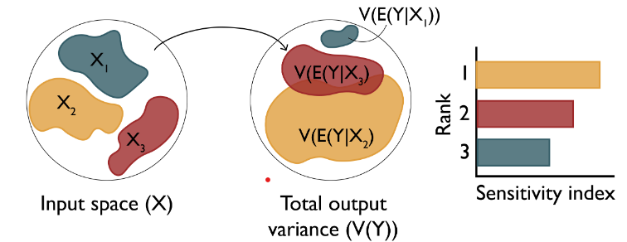
Research Objectives
Objective 1: Understand the key drivers of impact of malaria interventions in Ghana
Objective 3: Simulate the impact of malaria interventions in Ghana in order to support decisions for strategic planning
Objective 2: Develop a novel inference framework for calibrating the OpenMalaria model at a higher spatial resolution
Perform sensitivity analysis of coverage, halflife of efficacy and vector composition towards prevalence reduction (Forward Propagation of uncertainty)
Source: Sensitivity Analysis: The Basics

Slide 5
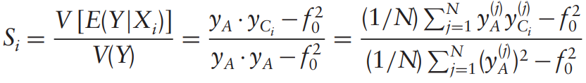
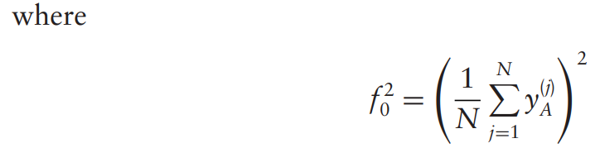
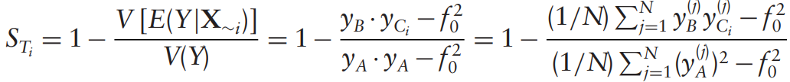
Variance-based sensitivity analysis (Sobol)

Slide 6
Objective 1 – Modifying the existing workflow
Chose a sampling scheme to reduce number of OM simulations and runtime
How do we reduce the number of OM simulations in order to drastically reduce runtime?
Tried other sampling designs instead of sweeps
Trained GP model on EIR, intervention coverages, prevalence reduction and used model to predict OM ouputs for sensitivity analysis
Choose a sensitivity method (compared soboljansen and sobolsalt)
Notes:
To address uncertainties, we identify and quantify the various sources of uncertainty in intervention modeling

Slide 7
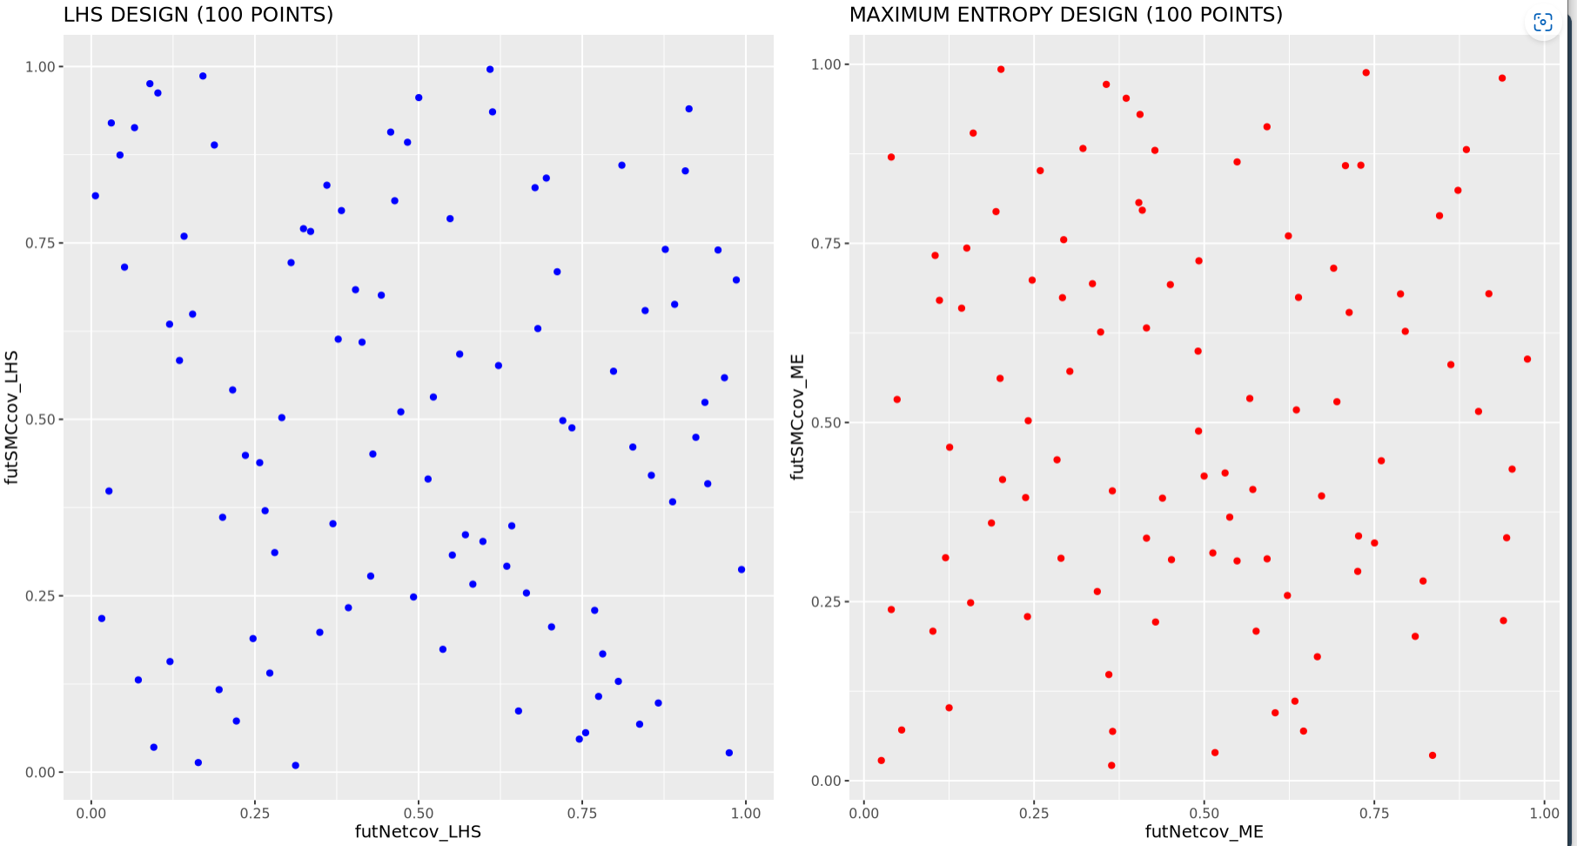
1 – LHS vs MED SAMPLING (100 POINTS)
LHS or ME sampling during simulation setup cuts runtime drastically

Slide 8
1 – LHS or ME sampling during simulation setup cuts runtime drastically
SETTING | NUMBER OF SIMULATIONS REQUIRED (SWEEPS) | NUMBER OF SIMULATIONS REQUIRED (LHS) | R-SQUARED | NUMBER OF X_COLS | GP TRAINING TIME (mins)
UPPER.EAST4 | 50K (submitted) | 1500 | 0.97 (sweep) | 4 | 11.9
OTI | 300000 (not submitted) | 2500 | 0.96 (LHS) | 4 | 1.9
BONO.EAST (no_LSM) | 212500 (not submitted) | 2000 | 0.95 (LHS) | 4 | 1.4
Notes:
LLINs is the most influential in determining the output variance

Slide 9
2 – GP performance evaluation - learning of prevalence reduction gives good statistical correspondence Actual vs predict for 3 settings: full EIR sweep for UE and LHS for Oti and BE
The GP was trained using all simulation data
Model performance was evaluated using R-sqaured
Notes:
LLINs is the most influential in determining the output variance

Slide 10
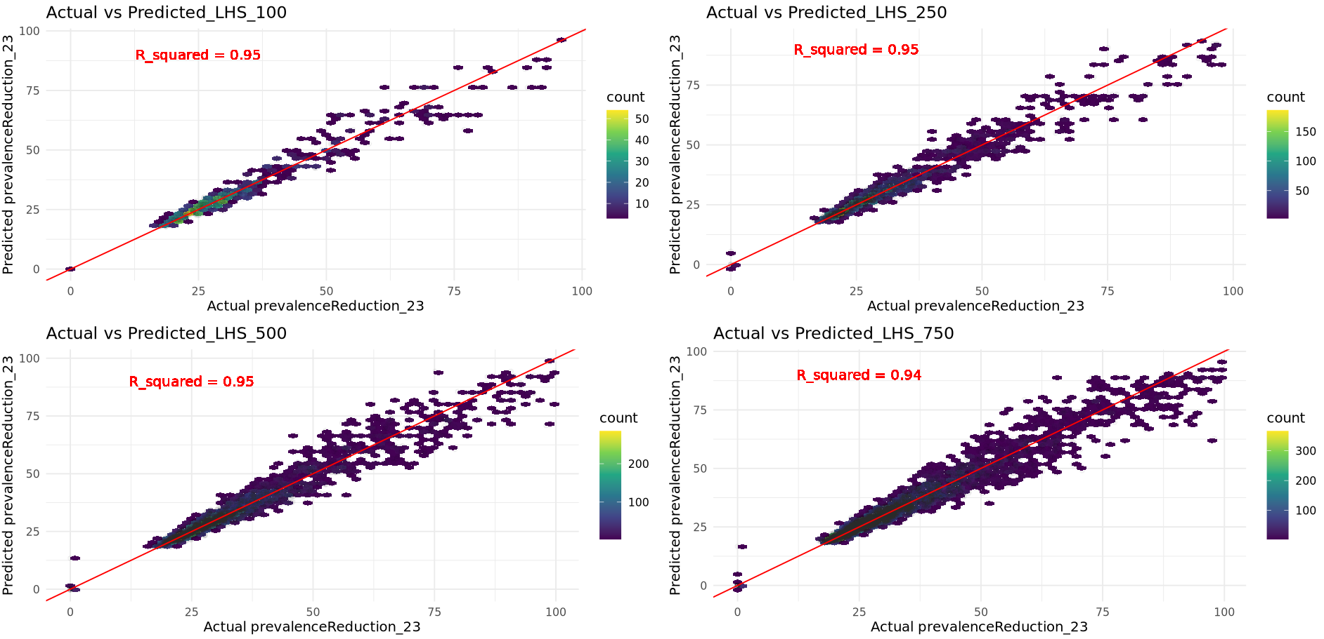
2 – GP performance evaluation - learning of prevalence reduction gives good statistical correspondence Actual vs predict using different LHS sample sizes for UE4
The GP was trained using all simulation data
Model performance was evaluated using R-sqaured
Notes:
LLINs is the most influential in determining the output variance

Slide 11
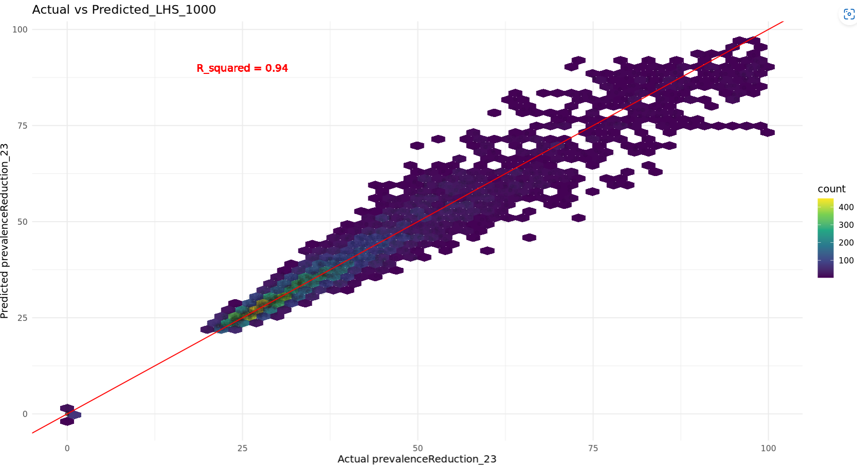
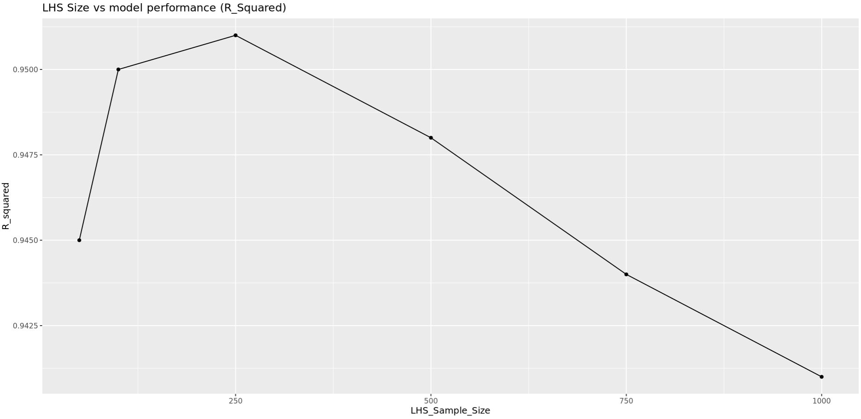
2 – GP performance evaluation - learning of prevalence reduction gives good statistical correspondence Actual vs predict using different LHS sample sizes for UE4
Notes:
LLINs is the most influential in determining the output variance

Slide 12
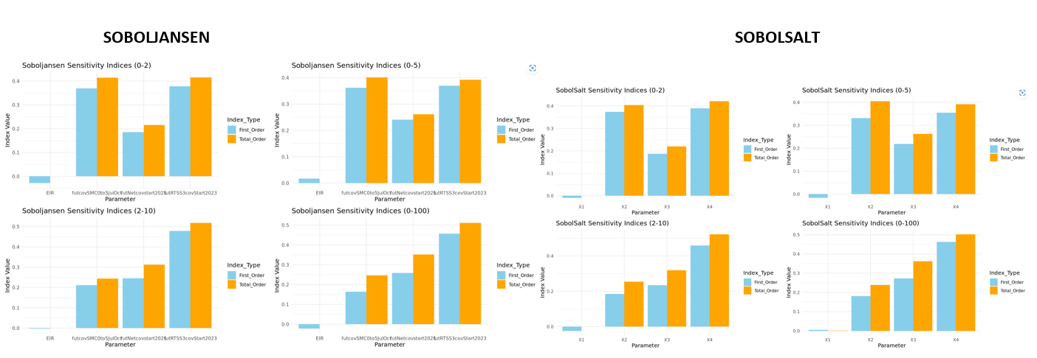
3 - Sobol methods comparison
Sobol sensitivity analysis of future coverages of malaria interventions for 3 settings in ghana: upper.EAST4, OTI and BONO.East.
Notes:
LLINs is the most influential in determining the output variance

Slide 13
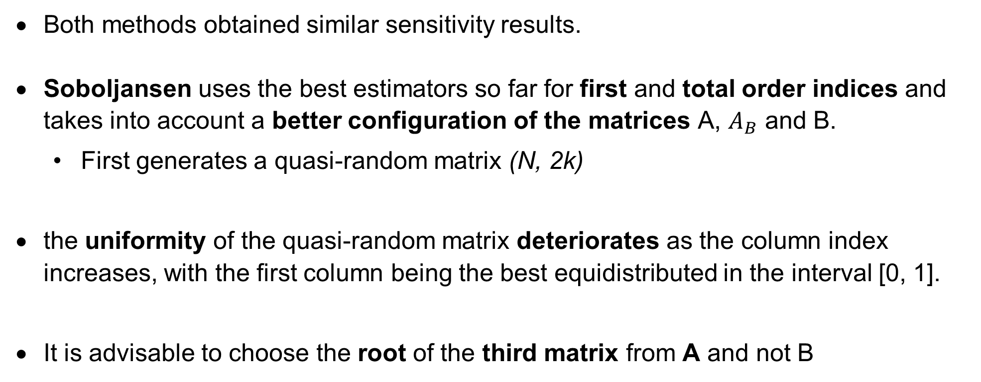
3 - Sobol methods comparison
Both methods obtained similar sensitivity results.
Soboljansen uses the best estimators so far for first and total order indices and takes into account a better configuration of the matrices A, $A_{B}$ and B.
First generates a quasi-random matrix (N, 2k)
the uniformity of the quasi-random matrix deteriorates as the column index increases, with the first column being the best equidistributed in the interval [0, 1].
It is advisable to choose the root of the third matrix from A and not B
Notes:
LLINs is the most influential in determining the output variance

Slide 14
Current setup for OM simulations and Sobol sensitivity analysis with setting-specific EIR ranges and realistic intervention coverage ranges
Sample size of LHS = 250 points
Include IRS in sensitivity analysis
Train a GP model for each setting for 0-5 age group, using the EIR full range from OM outputs + deployed intervention coverage ranges
Setting specific EIR use min EIR_lci and max EIR_uci values across sub as param ranges
Sobol Sensitivity analysis uses setting-specific EIR + realistic intervention coverage ranges of interventions to be deployed
Non-deployed interventions are indicated as NA on the first-order indices plot
Parameter ranges:
futcovSMC0to5JulOct_min = 0.4, futcovSMC0to5JulOct_max = 0.9,
futRTSS3covStart2023_min = 0.5, futRTSS3covStart2023_max = 0.9,
futNetcovstart2021_min = 0.2, futNetcovstart2021_max = 0.8
futIRScov_min = 0.2, futIRScov_max = 1.0
Notes:
LLINs is the most influential in determining the output variance

Slide 15
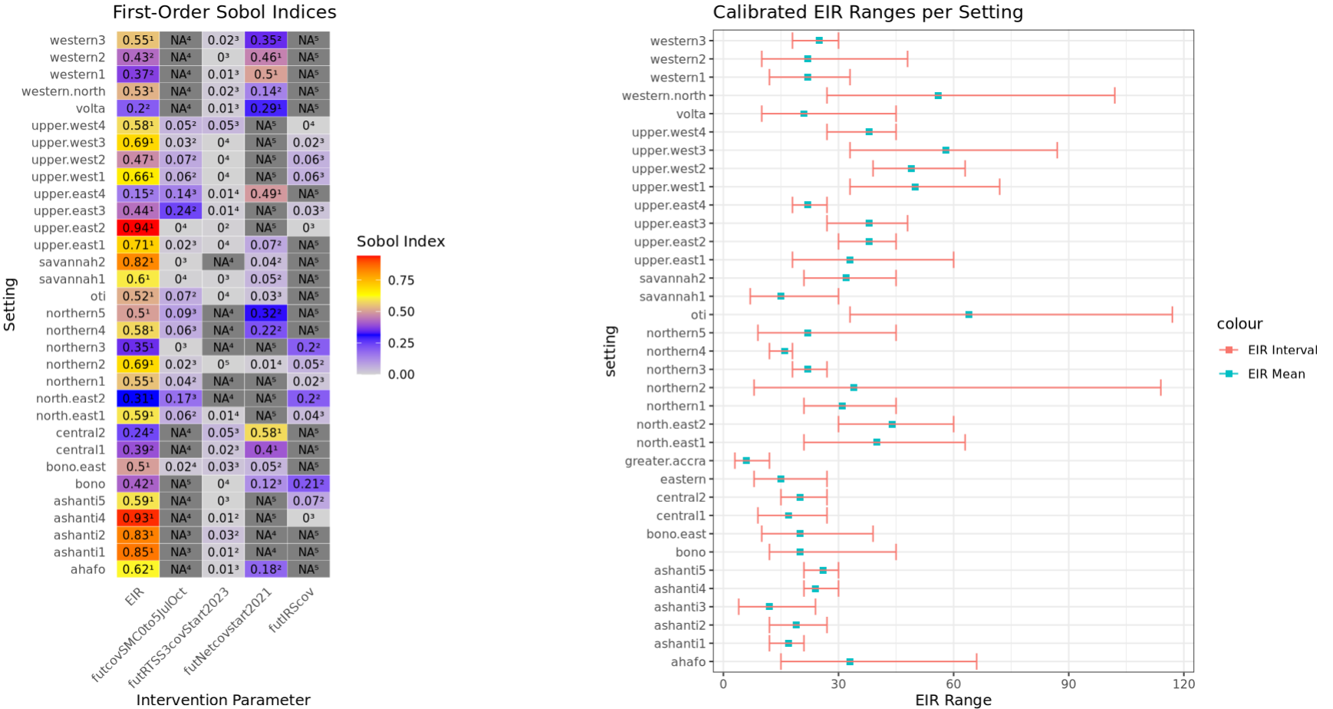
Sobol indices for 35 settings after integrating the above findings in the existing workflow – response = prevalence reduction
Notes:
LLINs is the most influential in determining the output variance

Slide 16
Next Steps
Get prevalence / incidence plots for each setting
Run sensitivity at fixed EIR_mean values for settings. Why?
EIR has already proved to be influential in prevalence reduction
We will be inferring it anyway in objective 2
Expand the sensitivity analysis by including other parameters (vector composition/efficacy)
Analyse the impact of removing/including each intervention per setting
Notes:
LLINs is the most influential in determining the output variance

Slide 17
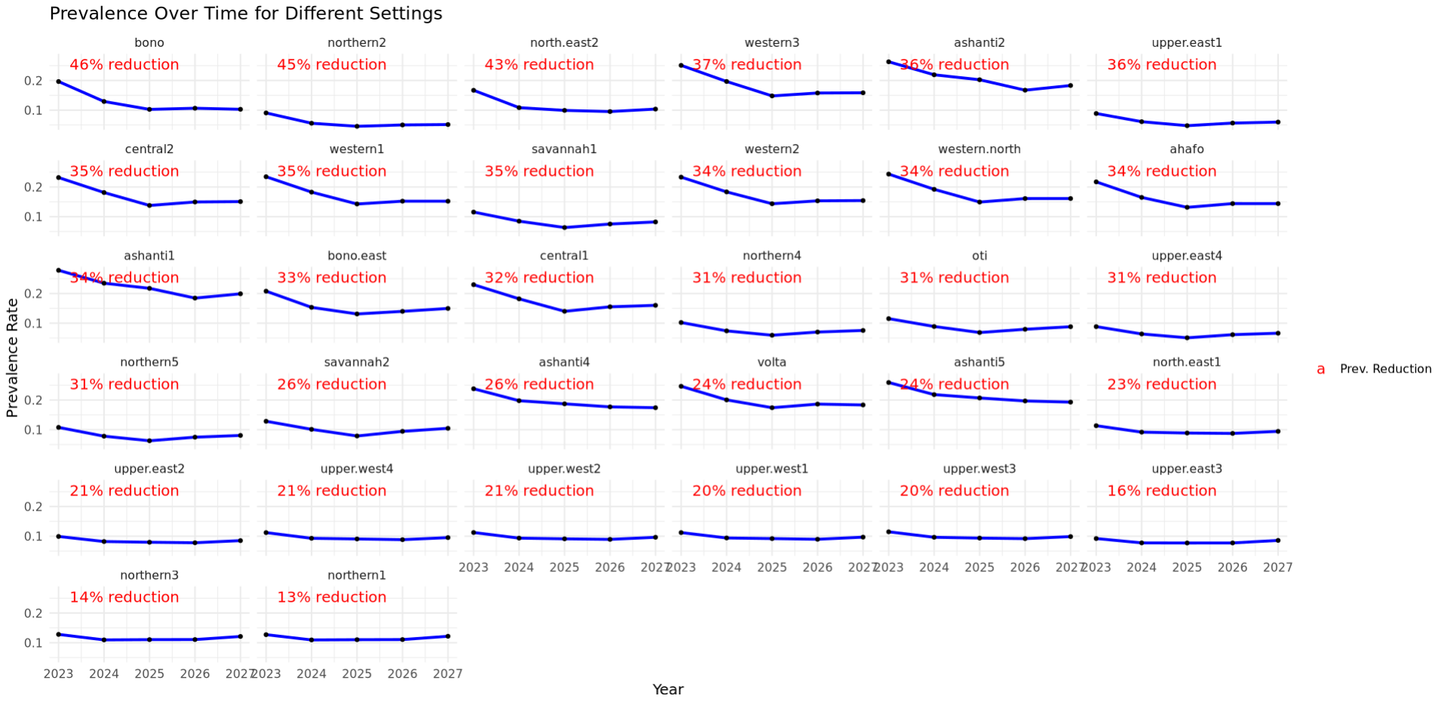
Prevalence over time per setting
Notes:
LLINs is the most influential in determining the output variance

Slide 18
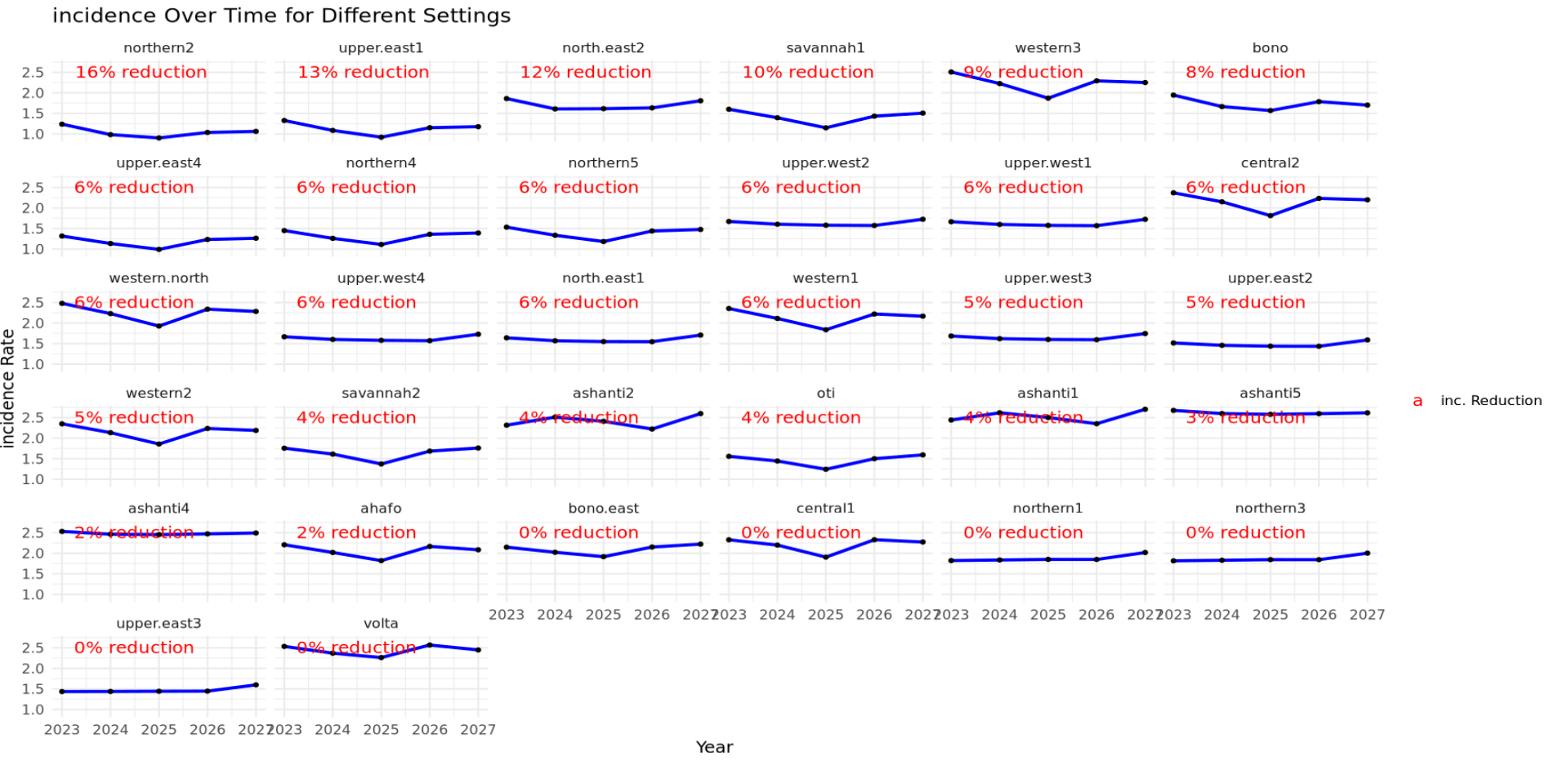
Incidence over time per setting (2023-2026 reduction)
Notes:
LLINs is the most influential in determining the output variance

Slide 19
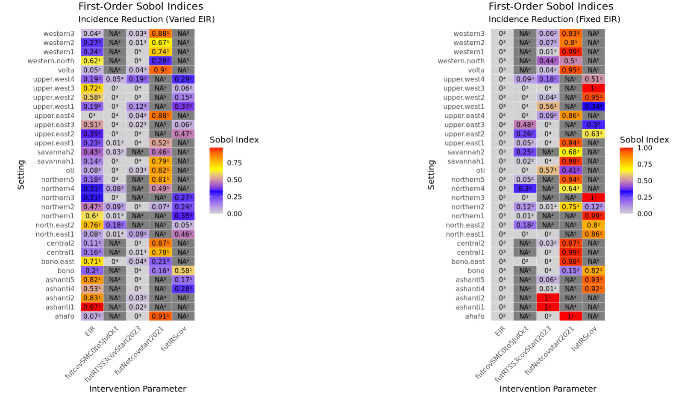
Sobol indices for 35 settings after integrating the above findings in the existing workflow – response = incidence reduction
Notes:
LLINs is the most influential in determining the output variance

Slide 20
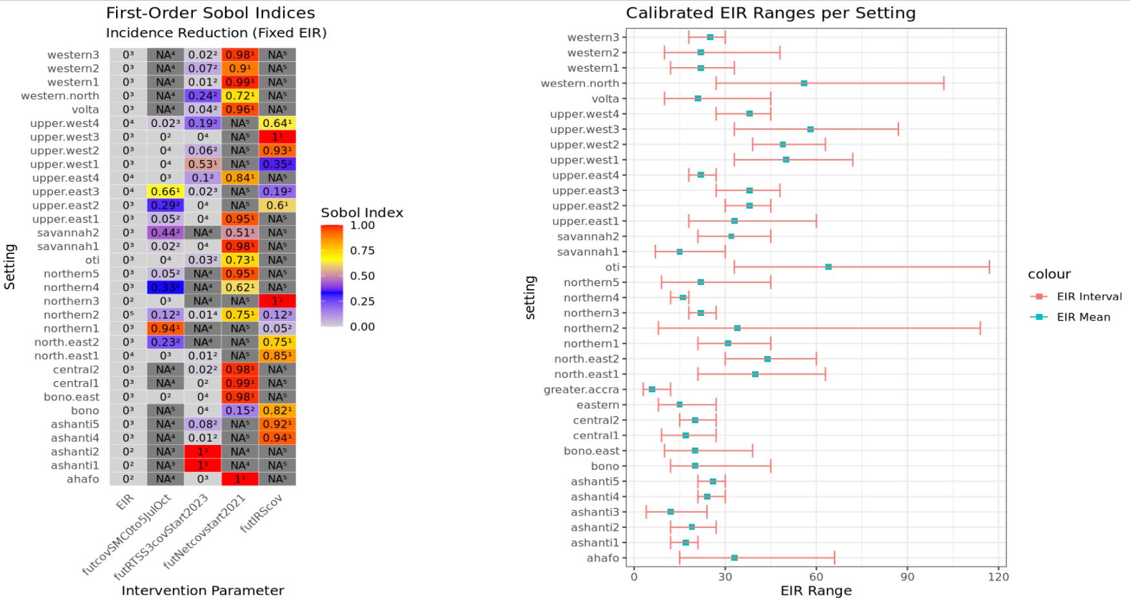
Sobol indices for 35 settings after integrating the above findings in the existing workflow – response = incidence reduction
Notes:
LLINs is the most influential in determining the output variance

Slide 21
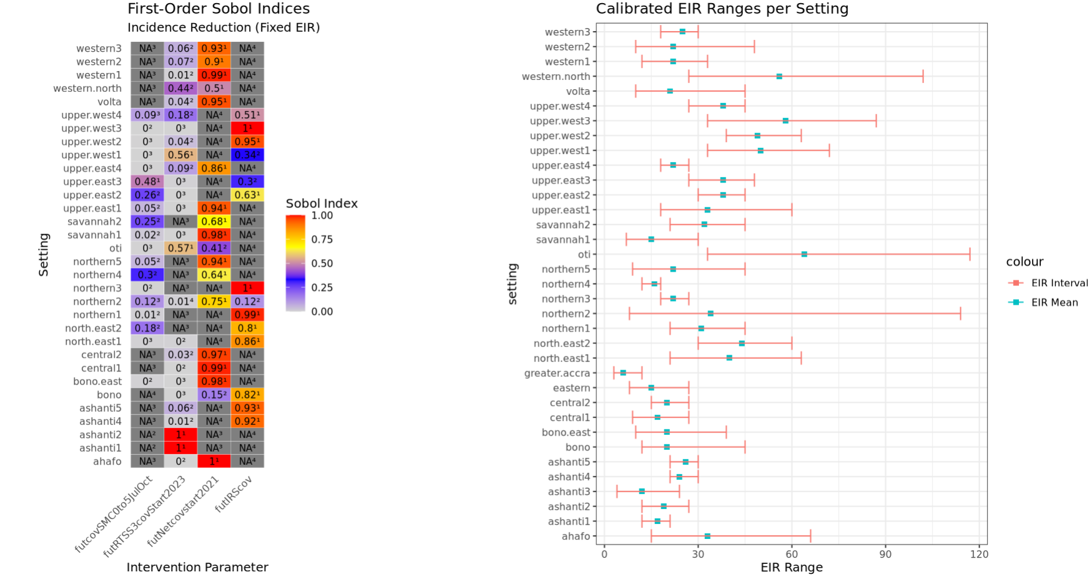
Sobol indices for 35 settings after integrating the above findings in the existing workflow – response = incidence reduction
Notes:
LLINs is the most influential in determining the output variance

Slide 22
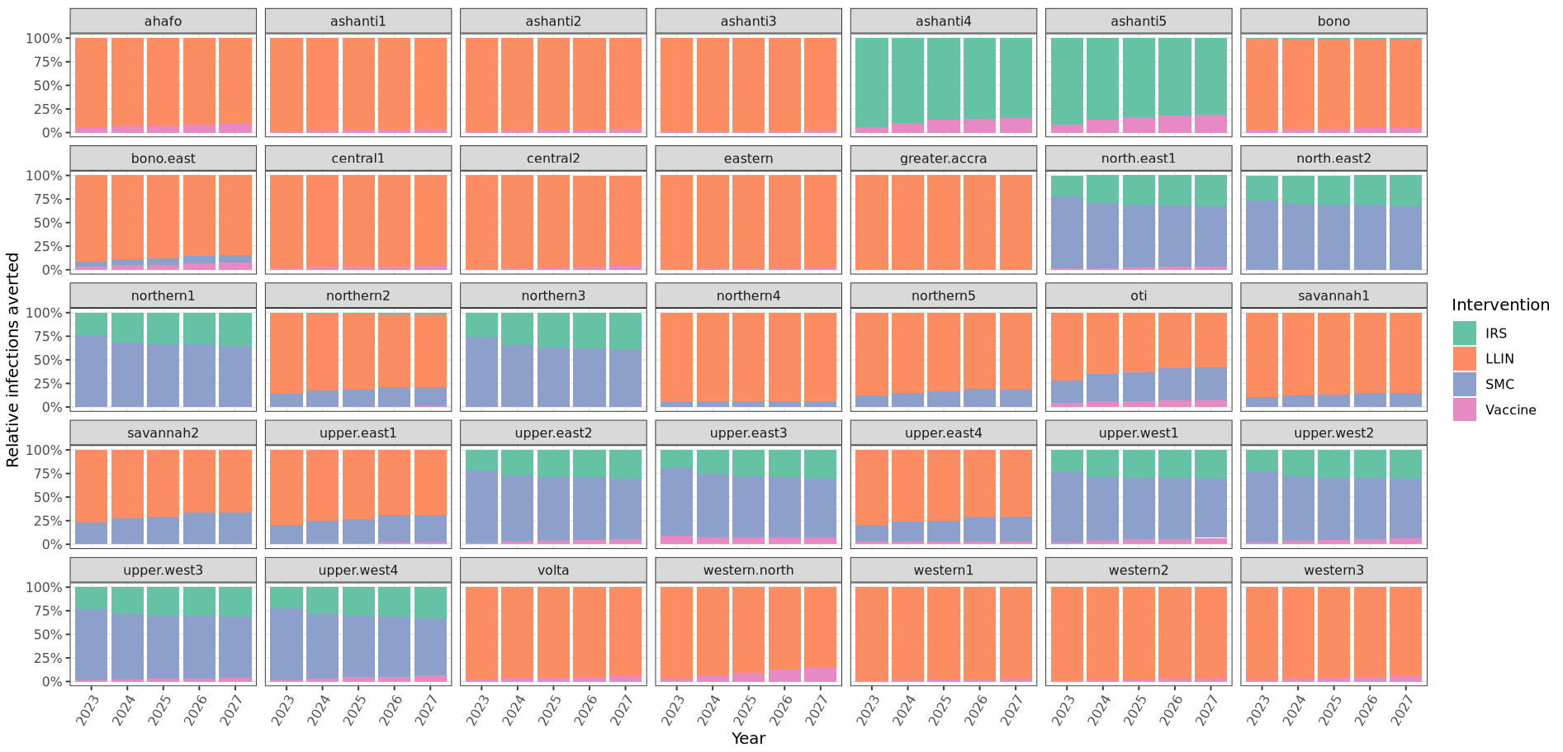
Relative cummulative cases averted over time by intervention per setting
Notes:
LLINs is the most influential in determining the output variance

Slide 23
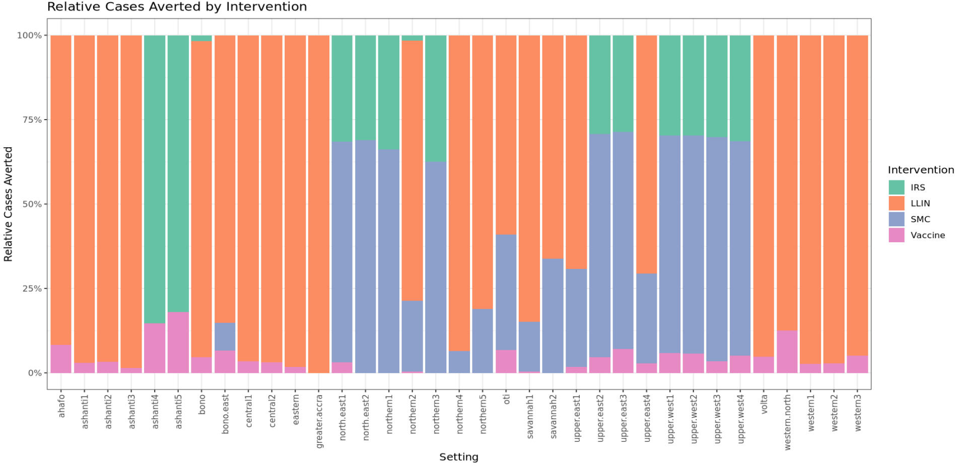
Relative cumulative cases averted (till 2026) by intervention per setting
Notes:
LLINs is the most influential in determining the output variance

Slide 24
Comparison and contemplations
a. Generally, ITNs in both cases are impactful and influential b. The impact of SMC is always higher when co-deployed with IRS, but the opposite is generally the case in the SA c. Vaccines had the least impact in general, which is consistent with the SA. IMPACT: ITN>SMC>IRS>RTSS SA: ITN>IRS>SMC>RTSS
NB: I realize that all the Ashantis show NA for LLINs in the SA, which is strange.
Within a setting:
Maintain or increase coverage for interventions with high impact and high sensitivity – eg. ITNs
Increase coverage for interventions with high sensitivity but low impact (underused?) – eg north.east1 and 2 ie., northern part of the country
Ideally, IRS should be given priority over SMC in such settings with high IRS sensitivity(cost?)
Notes:
LLINs is the most influential in determining the output variance

